Slide 1

tliq Business Insights 360
transformative journey leveraging Power BI for data analytics.

Slide 2

Business Insights 360
A transformative journey leveraging Power BI for data analytics.
In this initiative, we explore AtliQ Hardware's global operations, aiming to extract meaningful insights that will drive informed decision-making.
01
INTRODUCTION
Learning Journey
Guided by “codebasics” mentors Dhaval Patel and Hemanand Vadival.
Specific skills gained–
Power Query, ETL methodology, DAX, measures.
Creative use of Buttons, Parameters, Bookmarks.
Page navigation with hovering effect
Dynamic titles based on applied filters.
Distinct KPI indicators.
Creative conditional formatting using icons or background colours.

Slide 3
Introducing AtliQ Hardware
A significant player in the electronics market.
Senior executives of this company wants invest in a data analytics project.
Aims to enhance decision-making processes, ensuring a more resilient and competitive position in the industry.
02
Data Sets Details
Foundation: Dimension and Fact Tables
Dimension tables house static data and provide context and descriptive information
Fact tables contain transactional data, capturing the details of various business transactions
PROJECT OVERVIEW
ETL Process
Extract, Transform, Load (ETL) process was paramount.
We crafted a robust data model with multiple fact and dimension tables.

Slide 4
Snowflake schema
A structured data modeling method with a hierarchical tree-like structure.
Emphasizes data normalization.
Enhances data integrity, ensuring our information is accurate and reliable.
03
DATA MODEL
Navigating Data
A landscape involved Project Planning, a kick off session, applying project management skills, crafting over 60 key dax measures, Stakeholder Mapping and quick fixes.

Slide 5
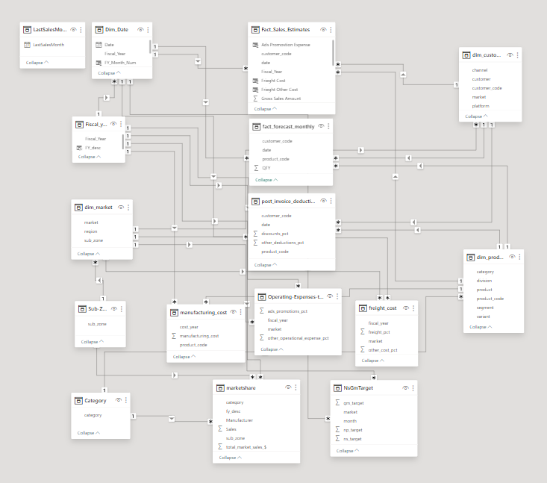
DATA MODEL DIAGRAM

Slide 6
Crafting Interactive Reports
A user-friendly home page and dedicated sections to help Finance, Sales, Marketing, Supply Chain, and Executive Team.
Comprehensive reporting structure ensures a holistic view of AtliQ Hardware's performance.
The sales data is up-to-date as of December 21st.
The Report was last Refreshed with new data on Date: 05 November 2023"
Currency is in INR.
04
REPORTING OVERVIEW
Interactive Features
Experience seamless navigation with interactive features and filters that enhance user engagement
Providing a dynamic and personalized analysis experience.

Slide 7
Financial Insights
The dashboard offers -
Profit and loss statements, key metrics (Net sales, gross margin, net profit), performance trend and benchmarks
These visuals assist the finance team with -
A clear and actionable snapshot of the company's financial health,
Empowering them to make data-driven decisions, optimize resources, and collaborate effectively.
Revealing profitability, cost drivers, sales trends, and historical data,
Enable them to understand the present, forecast the future, and make strategic decisions for sustainable growth.
05
FINANCE VIEW

Slide 8
Sales Performance Unleashed
Provides a granular understanding of AtliQ Hardware's sales dynamics like -
Reports on net sales, gross margin of top-performing products, customer net sales performance
The dashboard can assist the sales team by -
Tracking sales vs targets and identify areas of improvement.
Develop new sales strategies such as offering discounts or promotions to certain customer segments.
Identifying products and customers have the highest margins and net profits.
Focus efforts on acquiring and retaining customers in these areas.
06
SALES VIEW

Slide 9
Marketing Unveiled
Providing insights into AtliQ Hardware's marketing strategies and performance metrics.
The marketing team can use these visuals -
For information to identify areas where the segment is underperforming.
To allocate resources to the most profitable products and channels.
To develop targeted marketing campaigns for different products and channels.
07
MARKETING VIEW

Slide 10
Navigating the Supply Chain
Offering a closer look at the intricate processes that drive the business.
Forecast accuracy positive trend for customers is 81.17%, from 80.21% from previous year.
The net error is -$3.47 million, which means that the team is under-forecasting by this amount.
The supply chain team can use this dashboard:
For the information to identify areas where they can improve
To develop targeted inventory management strategies.
08
SUPPLY CHAIN VIEW

Slide 11
Insights for Leadership
A dashboard offering insights into revenue by division, channel, annual trends, market shares, top customers, and top products.
Provides insights of major KPIs.
The executive team can use this dashboard -
To identify areas where they can improve and they may want to ask
What are the reasons for the low net profit margin?
What is being done to improve forecast accuracy?
To track progress over time and measure the effectiveness of the actions taken.
To communicate the plan to all employees and stakeholders.
Ensuring working towards the same goals.
09
EXECUTIVE VIEW

Slide 12
THANK YOU

